Slide 1
Neural Networks: Physics Applications

Slide 2
Outline
Goal: See how we can use NN’s in physics
Focus on the idea of creating a Force-Field
How far can we go?
Why are NN’s so powerful?
Consequences that follows

Slide 3
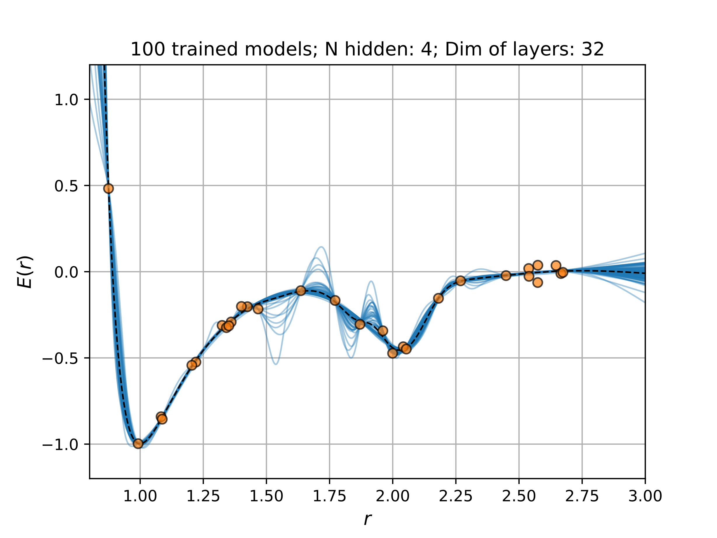
Why are they so powerful?
Universal function approximator
What about the physics?
Particle physics
Physics informed
What about uncertainties?
Massive datasets
Let’s say we have done experiment
Find force-field & use

Slide 4

Example: Fitting potential
Only assumption: $V\left(r_{ij}\right)$
Measured atom configuration & global energy in some way

Slide 5
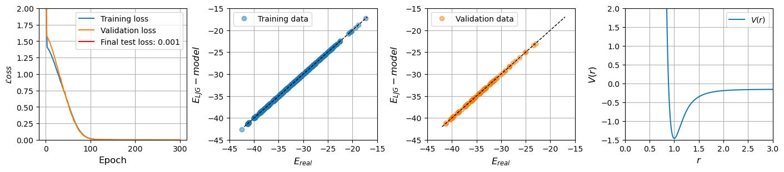
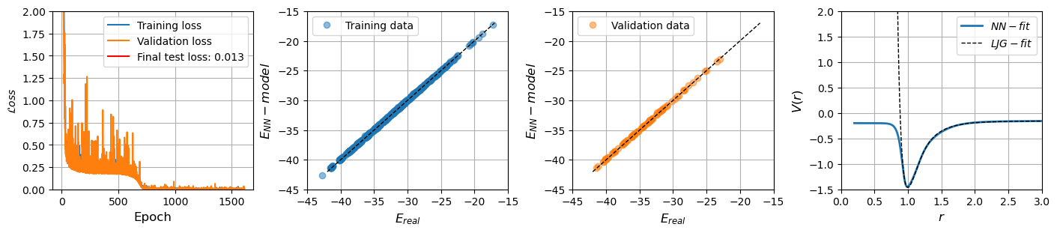
Example: Fitting potential

Slide 6
Example: Fitting potential

Slide 7
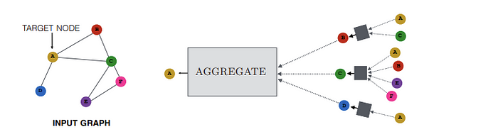
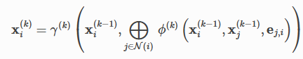
How much can we generalize and learn?
Perhaps too crude approximation earlier → GNN
Nodes and edges can have features
Construct messages & aggregate → Message Passing
We have to aggregate information in some way?
Sums it all up:

Slide 8
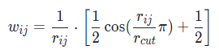
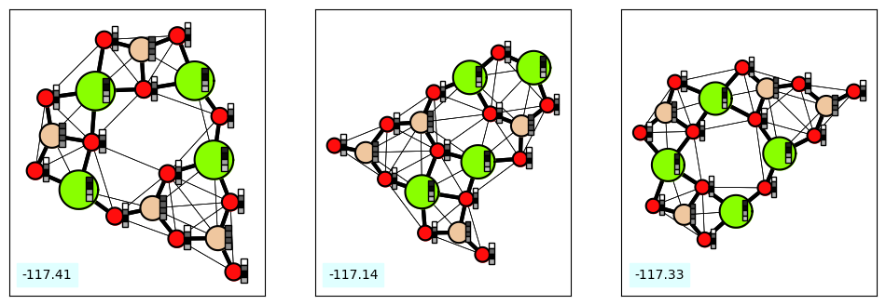
Different Example: Include bonds
Include atom features & Bond features

Slide 9
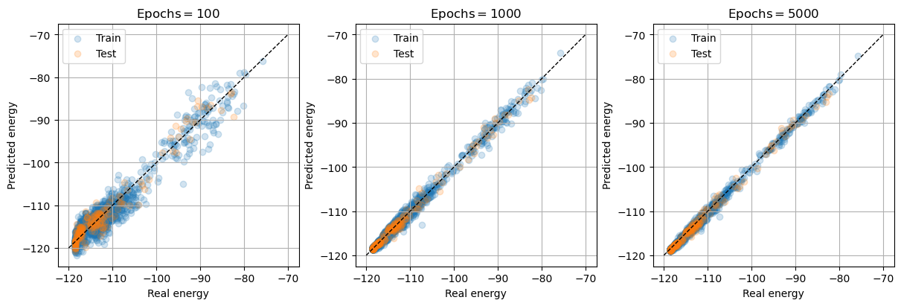
Different Example: Include bonds

Slide 10
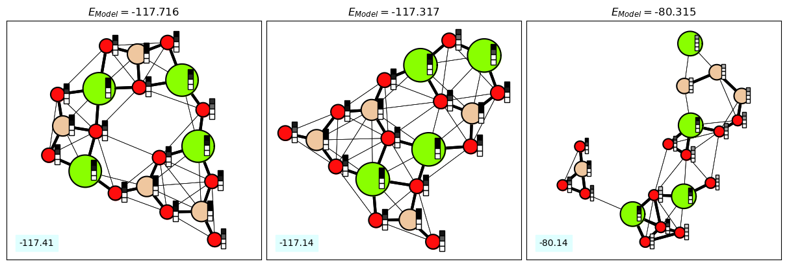

Slide 11
Different Example: Include bonds
Use in MD simulations → Very expensive with DFT
Velocity
verlet
Euler integration

Slide 12
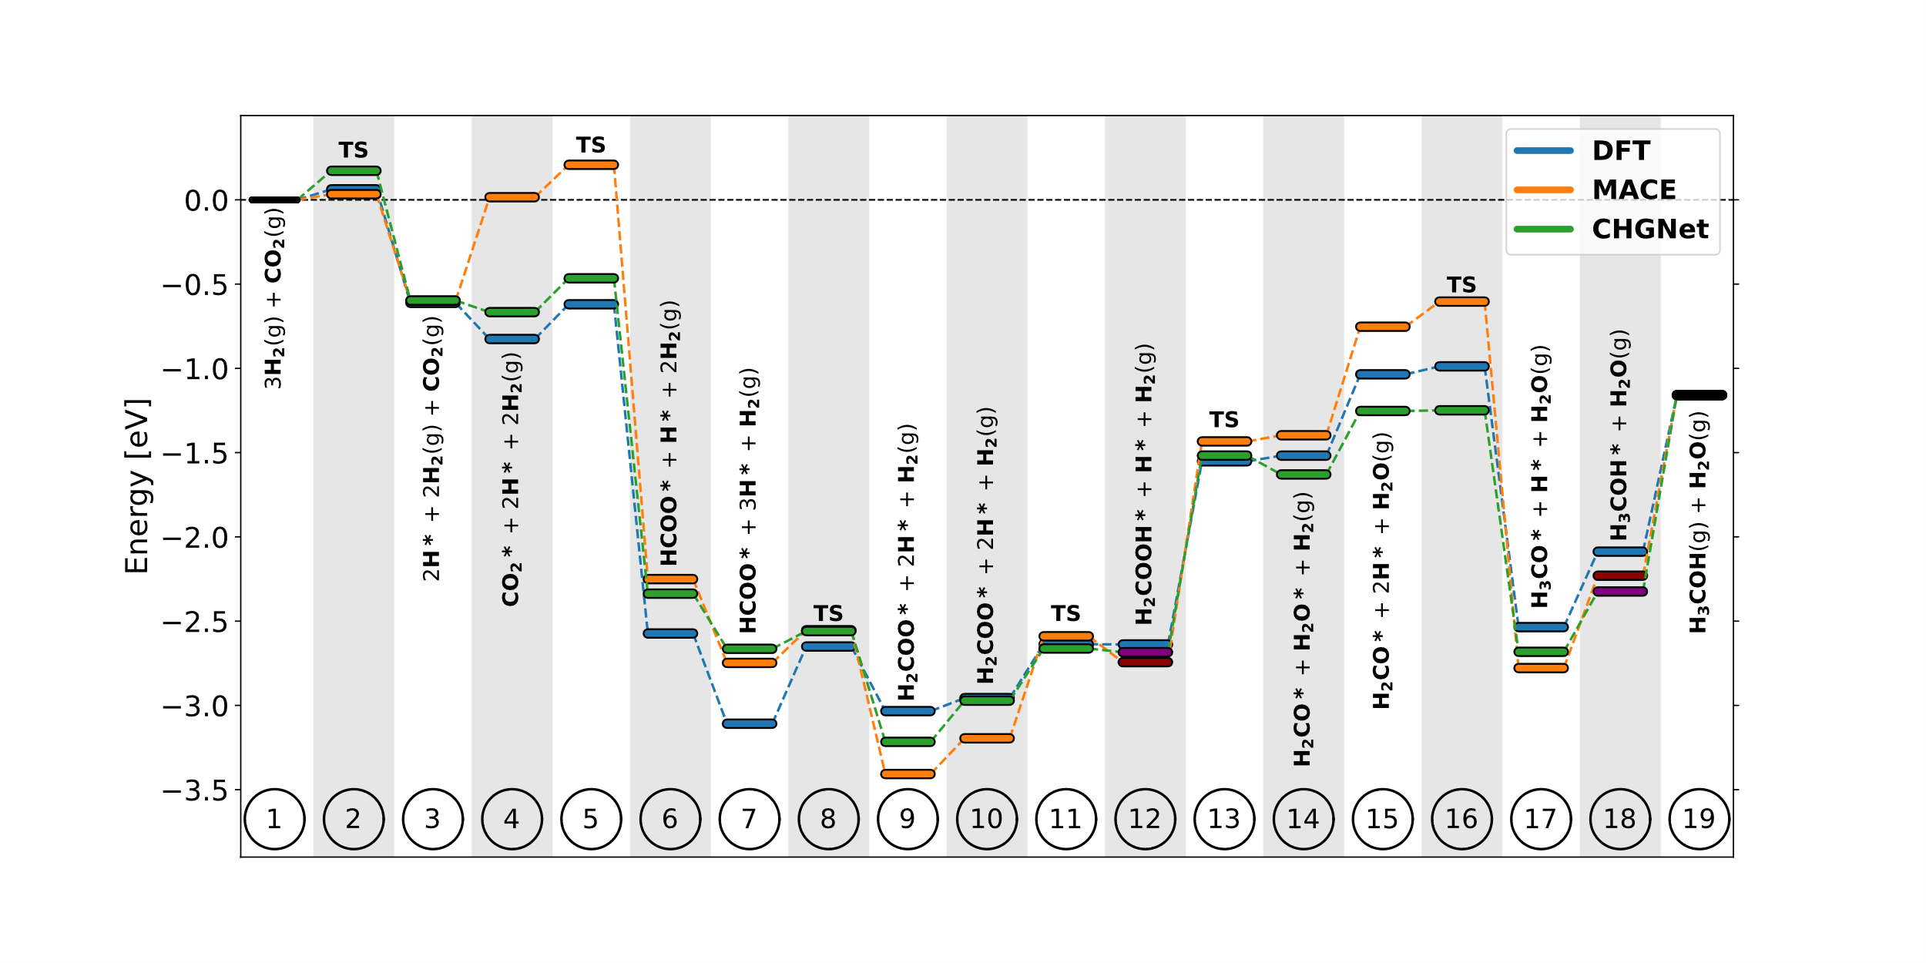
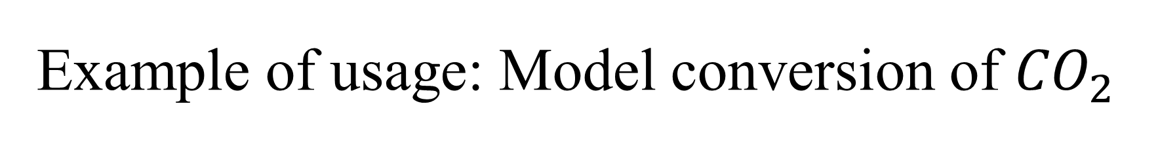
Example of usage: Model conversion of ${CO}_{2}$

